Slide 1

Welcome
Notes:
Topic: Peer-to-Peer Support
Time: 30 minutes
Purpose of training evolution: Sailors will examine the concept of peer-to-peer support to engage fellow Sailors in conversation using effective communication and knowledge of resources.
Expected outcome of training evolution: Sailors will learn to use peer-to-peer support to engage fellow Sailors using confidential communication and empathetic listening along with available support options.
Safety: Inform Sailors of safety hazards in the training environment. For some topics, Sailors should be informed if there is a designated person to talk to if the Sailor feels compelled to leave the training.
Facilitator Actions:
Display slide.
Greet Sailors.
Introduce yourself and give any background on yourself that might be of interest.
Establish credibility.
Facilitator Instructions:
The slide deck acts as a guide to present a facilitated discussion that may include activities.
Best practice: Use the slide to develop interest in the subject matter. Do not read the slides word for word. The Sailors should be able read the text and understand the messaging presented in the graphics.
Facilitator notes are available for each slide to help the Facilitator deliver the topic.
Best practice: Use the Slide Show view to ensure the Facilitator notes are viewable.
The Facilitator notes are divided into general instructions for Facilitator Actions (mechanics of facilitation) and the Facilitator Content (Inform, Discuss, Perform, and Reference).
Best practice for Inform: Present facts, concepts, and procedures. Depending on the subject matter, these may be written as suggested talking points or scripted material (denoted by quotation marks).
Best practice for Discuss: Conduct large-group question and answer sessions or large-group, Facilitator-led activities. Depending on the subject matter, these may be written as questions with expected answers or scripted activities.
Best practice for Perform: Facilitate small-group, scenario-based or procedural activities. Depending on the subject matter, these may be written with specific actions the Sailors will take or general ways for the Facilitator to monitor the activities. The Facilitator will be provided with expected outcomes to ensure Sailors leave training with correct information.
Best practice for Reference: This is for Facilitator use only.

Slide 2
Introduction
Warrior Toughness
MIND • BODY • SPIRIT
Peer-to-Peer Support
Notes:
Facilitator Actions:
Display slide.
Introduce topic.
Let Sailors know that they can leave the discussion if they have to for their own well-being.
Ensure that misinformation is corrected immediately.
Monitor the discussions of the Sailors throughout the training event.
Facilitator Content:
To build Warrior Toughness, Sailors will examine the concept of peer-to-peer support to engage fellow Sailors in conversation using effective communication and knowledge of resources.
Sailors will learn to use peer-to-peer support to engage fellow Sailors using confidential communication and empathetic listening along with available support options.

Slide 3
Learning Objective
Peer-to-peer support is a daily form of care used to support individuals experiencing a stress reaction. Sailors supporting one another is the first line of defense in managing the harmful effects of stress.
Notes:
Facilitator Actions:
Display slide.
Neither Sailors nor Facilitator should read the objective out loud.
Facilitator Content: N/A

Slide 4
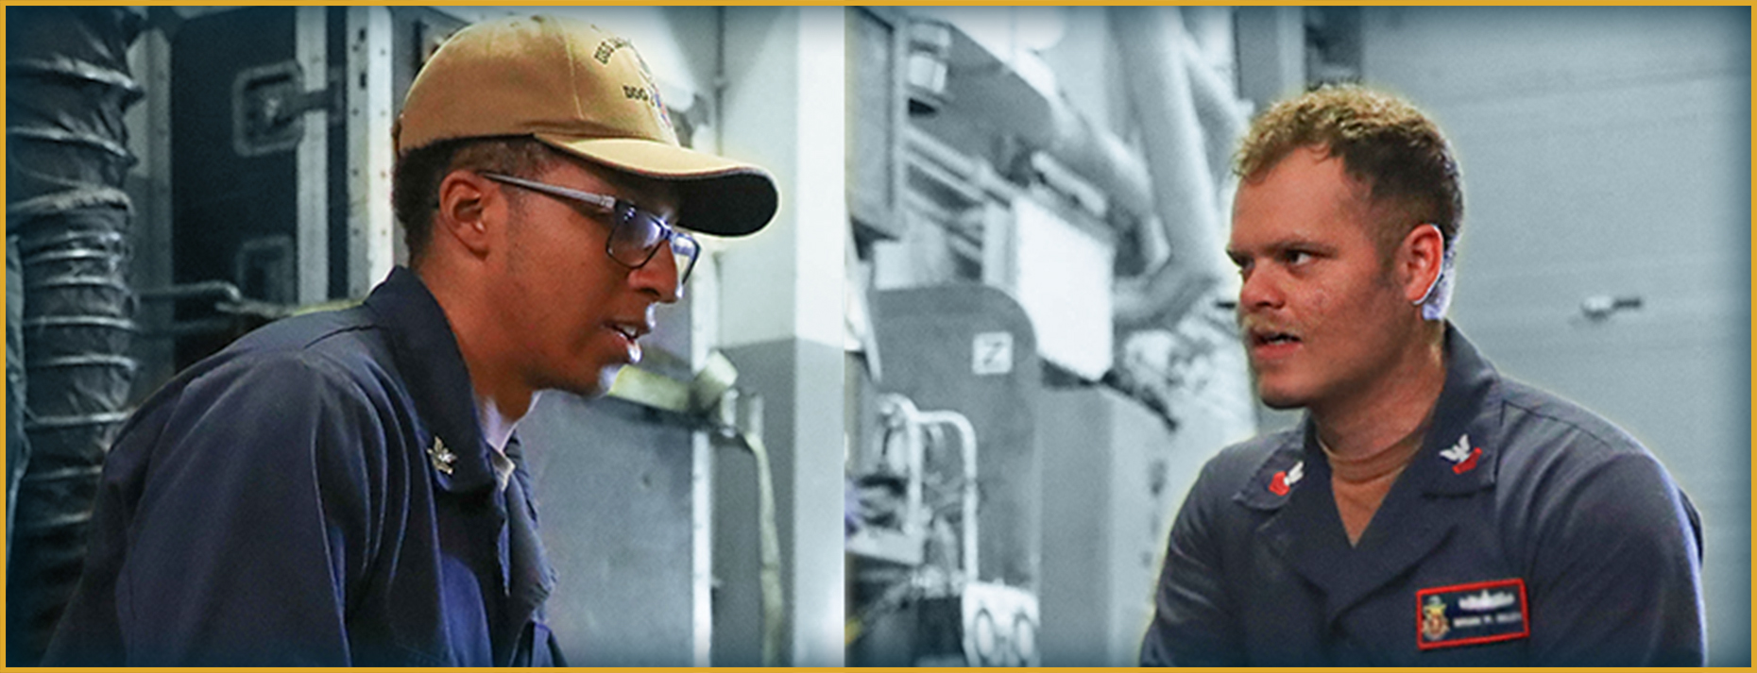
Breaking the Code of Silence
What does breaking the code of silence mean to you?
Notes:
Facilitator Actions:
Display slide.
Discuss how graphic relates to topic.
Monitor the discussions of the Sailors.
Facilitator Content:
Inform:
Breaking the code of silence normalizes the process of seeking and asking for help.
It also enforces that it is okay to ask for help during times of distress.
We cannot keep things bottled up. Eventually, that energy will be released and can be damaging.
Any illness or injury can and will get worse before it gets better without proper guidance or assistance.
We must be able to identify the signs and symptoms and create a safe environment and a positive culture that supports Sailors in asking for help and making it okay to intervene and engage.
Discuss:
What does breaking the code of silence mean to you?
What are some good examples of keeping things bottled up? What were the results?

Slide 5

Barriers
What are some barriers that may prevent you from seeking assistance?
Notes:
Facilitator Actions:
Display slide.
Discuss how graphic relates to topic.
Monitor the discussions of the Sailors.
Facilitator Content:
Inform:
Barriers to seeking assistance include the following:
Stigma: I will be seen as weak, others might have less confidence in me, leaders will blame me for problems, and it would be embarrassing to my family.
Trust in leadership: Difficulty revealing personal details to an individual, concern their information won’t be kept confidential or that it may negatively impact their military career.
Time and energy: Being too tired or too busy from working all day and dealing with emotional stressors that we have no time or energy left to talk to someone for help.
Lack of understanding and support by leadership: Lacking an understanding of mental illness and thinking an individual may not need help. Individuals dismiss or minimize their own issues, saying, everyone gets stressed out or my problems aren’t that bad.
Fear of reprisal: Sailors are afraid to take the steps to get help because they believe it might reflect badly on their character or have negative repercussions for doing so.
Access: Even if an individual is interested in getting help, many believe they have limited access to care or are unaware of how to get it.
Lack of communication: The more we talk about getting help, the less stigma and fear our Sailors will experience in seeking assistance.
Discuss:
What are some barriers that may prevent you from seeking assistance?
What can we do to remove or prevent these barriers?

Slide 6
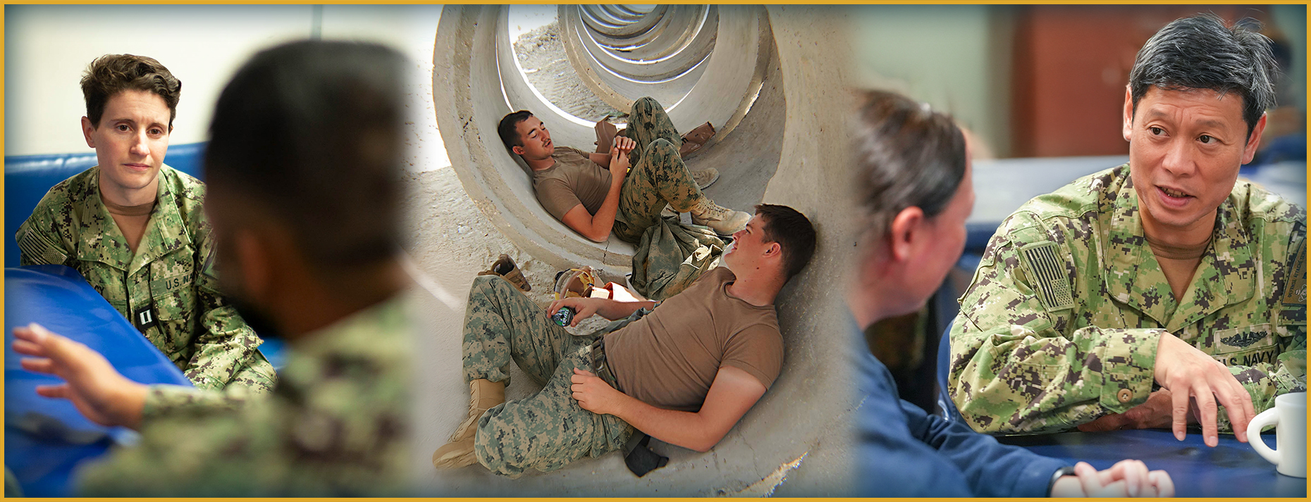
Peer-to-Peer Support
What is peer-to-peer support?
Notes:
Facilitator Actions:
Display slide.
Discuss how graphic relates to topic.
Monitor the discussions of the Sailors.
Facilitator Content:
Inform:
Peer-to-peer support engages individuals during times of stress when they need support from a friend or a peer.
The peer provides an early intervention strategy to normalize the process of seeking help.
Peer-to-peer support is not:
A therapy session: Peer-to-peer support is an interaction that involves peers of all disciplines.
Being a counselor: Most peers are not professionally trained counselors.
Pressuring someone to seek treatment: Pressuring individuals to seek treatment doesn’t work. Seeking help is something the individual needs to want.
A way to reveal private or damaging information: Disclosing personal information can be hurtful and damaging.
A means of gossip: Spreading gossip is unethical, irresponsible, and hurtful.
Discuss:
What is peer-to-peer support?
Have you ever provided support to a friend or co-worker?
What isn’t peer-to-peer support?

Slide 7
Assessing Stress
How can you use the Stress Continuum to determine if a peer is in distress?
Not Engaged | Ready | Reacting | Injured | Ill
Disinterested Unmotivated Unfocused No initiative Unproductive Limited involvement in work relationships | Good to go Well trained Fit and focused Connected Accepting new challenges Active coping Effectively Manages stress | Quick temper Irritable Diminished self-control Poor focus Poor sleep Temporary & transitory Needed for growth Withdrawing from usual social activities | Serious or significant distress or impairment due to: W.I.L.T. (i.e., Wear & Tear, Inner Conflict, Loss, & Life Threat) Overwhelming emotions Insomnia, nightmares Breaking relationships Shame, guilt Destructive behavior | Stress injuries that don’t heal without help Diagnosable mental health and substance use disorders
LEADERSHIP OPPORTUNITY | OPTIMAL PERFORMANCE | SELF-CARE OPPORTUNITY | POINT OF INTERVENTION | RECOVERS WITH EFFECTIVE CARE & REINTEGRATION
NOT ENGAGED
READY
REACTING
INJURED
ILL
Notes:
Facilitator Actions:
Display slide.
Discuss how graphic relates to topic.
Monitor the discussions of the Sailors.
Facilitator Content:
Inform:
Assess the Sailor’s stress based on the Stress Continuum Model.
If the Sailor is in the yellow or orange zones, engage peer-to-peer support.
If the Sailor is in the red zone, higher levels of care are required.
Discuss:
How can you use the Stress Continuum to determine if a peer is in distress?

Slide 8
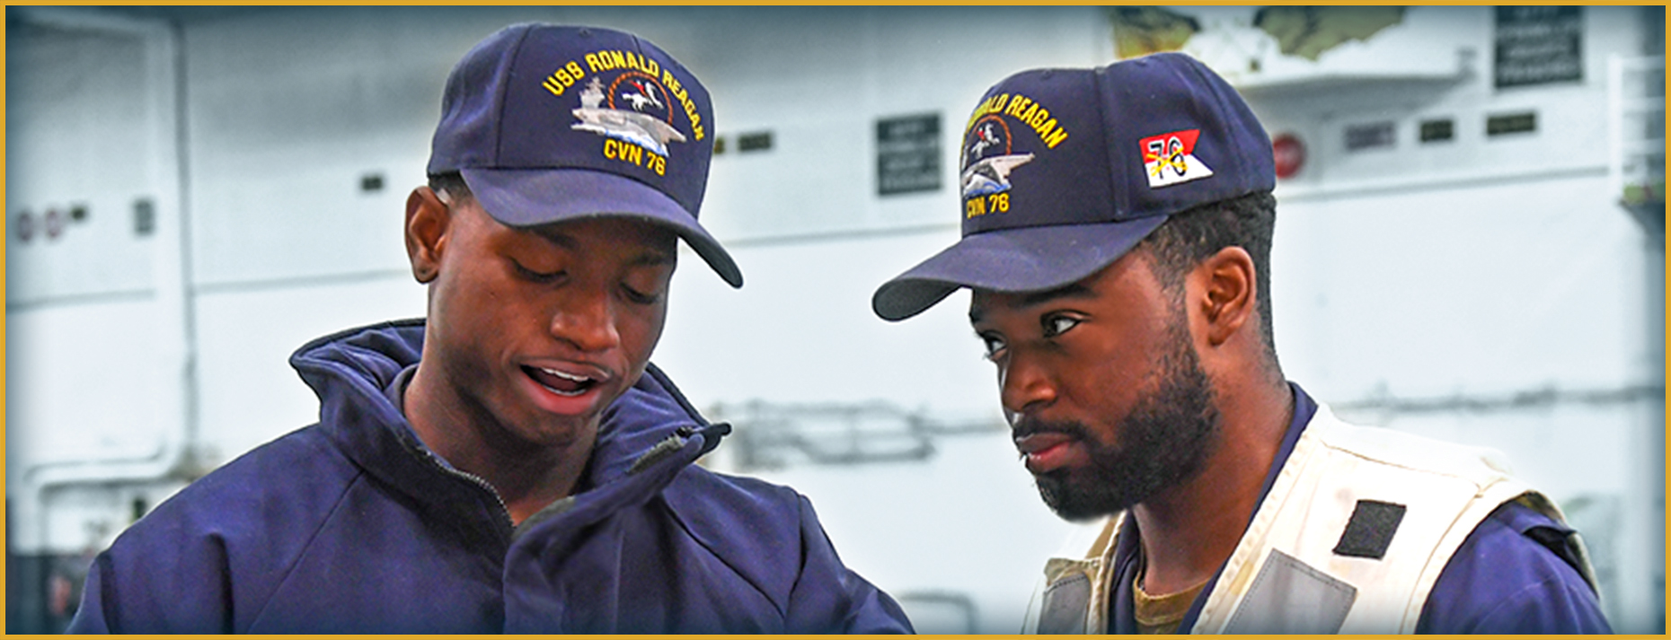
Confidential Communication
What are examples of confidential communication?
Notes:
Facilitator Actions:
Display slide.
Discuss how graphic relates to topic.
Monitor the discussions of the Sailors.
Facilitator Content:
Inform:
Peer-to-peer support is an informal peer-to-peer interaction and is not legally confidential.
If certain topics come up in the conversation, the peer should stop the conversation and offer the proper resource.
The peer should offer to go with the member to conduct a warm handoff to the proper resource.
Discuss:
What are examples of confidential communication?
What topics should stop the conversation?
Sexual assault
Sexual harassment
Drug or alcohol use
Legal matters
Spiritual matters that may involve confidentiality
Command Managed Equal Opportunity (CMEO)-related issues
Suicide-related issues

Slide 9
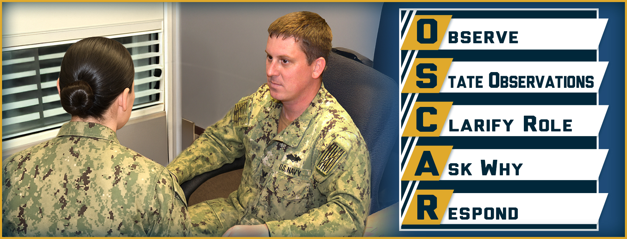
OSCAR Communication
How would you identify, engage, and intervene?
Notes:
Facilitator Actions:
Display slide.
Discuss how graphic relates to topic.
Monitor the discussions of the Sailors.
Facilitator Content:
Inform:
OSCAR Communication is a five-step tool to guide how you ask questions, show care, and assess the need for support.
Use OSCAR Communication when talking with a peer who is stressed, especially if they don’t realize or don’t want to admit it.
The steps of OSCAR Communication:
Observe: Actively observe behaviors. Look for patterns.
State observations: Address behaviors only, just the facts, without interpreting or judging.
Clarify role: State why you are concerned. This validates why you are addressing the issue.
Ask why: Seek clarification. Try to understand the other person’s perception of the behavior.
Respond: Clarify concern, if indicated. Discuss desired behaviors. State options in behavioral terms.
Discuss:
How would you identify, engage, and intervene?

Slide 10
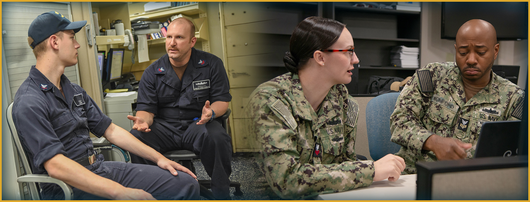
Empathetic Listening
What is empathetic listening?
Notes:
Facilitator Actions:
Display slide.
Discuss how graphic relates to topic.
Monitor the discussions of the Sailors.
Facilitator Content:
Inform:
Empathetic listening is perspective-taking.
Do not judge the person or their perspective.
Recognize the emotion; it isn’t necessary to agree with the person, simply acknowledge their emotions.
Reflect your understanding of what is being said.
It’s not about solving the problem but allowing the individual to share their story.
Discuss:
What is empathetic listening?
How can you apply empathetic listening?
Perspective taking: Appreciate the other person's reality.
Stay out of judgment: Listen in an active and nonjudgmental way.
Recognize emotion: Be sensitive to the other person’s feelings.
Reflect your understanding: Communicate your understanding of what is being said (verbally and nonverbally).
Perform:
Have Sailors discuss what empathetic listening is and have them practice empathetic listening with each other.

Slide 11
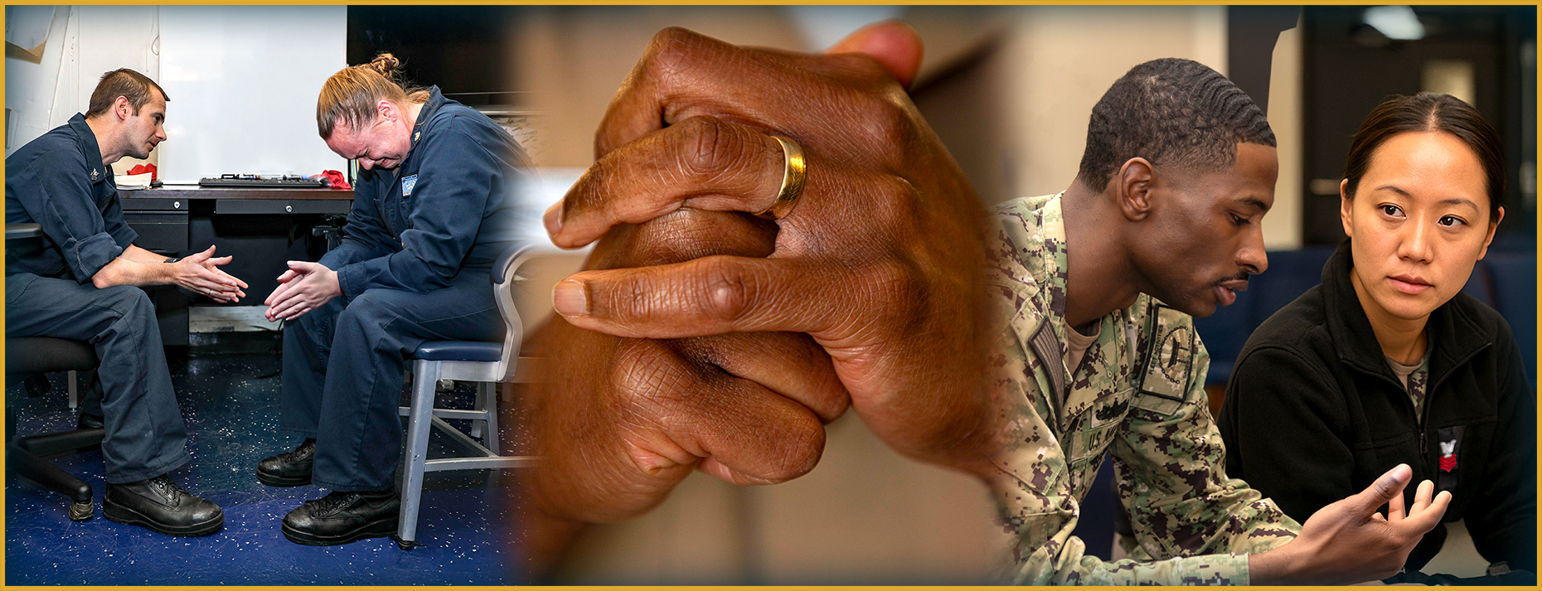
Support Options
When would you provide emotional support?
Notes:
Facilitator Actions:
Display slide.
Discuss how graphic relates to topic.
Monitor the discussions of the Sailors.
Facilitator Content:
Inform:
The following are types of support options:
Emotional: To feel loved or cared for, usually by a spouse, family, or a pet. This type of support can be expressed with words or gestures.
Affirmational: To feel valued or respected. Individuals may elicit this support from work, military service, family responsibilities, or as a volunteer.
Belonging: To feel like part of a community, such as the community where they live, a professional organization, a religious group, or a family member.
Informational: To learn or access needed information. This type of support is when you need to learn something or find out information by using the Internet, social media, or a Sailor.
Tangible: To help with practical needs. This type of support addresses practical needs, such as getting a ride to an appointment from a friend or neighbor.
Discuss:
When would you provide emotional support?
Wear and Tear (repetitive or persistent burdens)
Inner Conflict (values conflict)
Loss (financial, relationship, death of a loved one, etc.)
Life Threat (near-death experience or other catastrophic experience)
What are support options?
When would you use each type of support?

Slide 12

Call to Action
Be empathetic! Help your buddy get back to the fight!
Notes:
Facilitator Actions:
Display slide.
Review topics discussed and ask if there are any questions.
Check Sailor comprehension by providing review questions and/or problems.
Discuss how the call to action supports and encourages Sailors’ post training.
Relate call to action to Warrior Toughness.
Facilitator Content: N/A

Slide 13

Warrior Toughness QR Code
Notes:
Facilitator Actions:
Display slide.
Facilitator Content:
Inform:
Identify Warrior Toughness QR code.

Slide 14
References
Tools and Resources
988 Lifeline: If you need emotional support, reach out to the national mental health hotline: 988.
Chaplains: SECNAVINST 1730.11, complete Confidential Communication authority (Ref RP)
Notes:
Facilitator Actions:
Display slide.
Facilitator Content:
Inform:
Identify tools.
Identify resources.

Slide 15
References (continued)
Tools and Resources
DoDI 6495.02, Volume 1, "Adult Sexual Assault Prevention and Response: Program Procedures," March 28, 2013, Incorporating Change 8, July 26, 2024
MyNavy: Fleet and Family Support
Military OneSource: Peer-to-Peer Support
Mental Health Playbook
MyNavy Family APP
Warrior Toughness Placemat
Notes:
Facilitator Actions:
Display slide.
Facilitator Content:
Inform:
Identify tools.
Identify resources.

Slide 16
Glossary
Glossary
Acronym | Term
APP | Application
CMEO | Command Managed Equal Opportunity
W.I.L.T. | Wear & Tear, Inner Conflict, Loss, & Life Threat
WT | Warrior Toughness
Notes:
Facilitator Actions:
Display slide.
Facilitator Content: N/A

